Slide 1
Start an Actionable Automation & Augmentation Plan
Overview
This lesson focuses on starting an actionable automation and augmentation plan. It guides students through the steps of developing a concrete plan for implementing automation and augmentation in their workflows.
Learning Objectives
Identify which tasks are able to be automated or augmented, and which have lower potential.
Apply this skill to your own role, to enable you to design an automation and augmentation plan.

Slide 2
Suggested Agenda (45 minutes)
0:00-0:02 Review Learning Objectives
0:02-0:25 Identifying Tasks to Automate
0:25-0:40 Practice: Triaging the Tasks in your Role
0:40-0:45 Reflection
*these are estimates - timings will vary!

Slide 3
Teaching Guide:
Use the following quick tips for instructional guidance.
Title | What to Do
Learning Objective Slides | Pause to unpack the learning objectives and prime students for the lesson. This is a crucial step in the learning process and gives participants time to build context and activate any prior knowledge.
Solo Activities | For solo activities, you can choose to put people in group breakout rooms (to create the “table” group that they would be in in a physical setting) or allow students to work independently in the main session.
Group and Partner Discussions and Exercises (Remote) | Creating Breakout Rooms — Group and Partner Exercises Set up breakout rooms for pairs/groups. Broadcast directions and discussion questions to all breakout rooms. At the 60-seconds-left mark, broadcast a message to all rooms: “Start to wrap up your discussions. Rooms will close in one minute!” Move around from breakout room to breakout room to “walk around the classroom.”
Group and Partner Discussions and Exercises (In Person) | Facilitating Group and Partner Discussions and Exercises — Live Classroom Arrange the room prior to the session to create a conducive environment for group work. Provide clear, concise instructions verbally and on a handout or slide for the exercise, ensuring that all participants are aware of the goals and the time allocated. Circulate around the room to engage with groups Display a timer or announce when there is 1 min remaining Facilitate the sharing of group conclusions or discussion points with the whole class, ensuring that each group has a voice.

Slide 4
Start an Actionable Automation & Augmentation Plan

Slide 5
Identify which tasks are able to be automated or augmented, and which have lower potential.
Apply this skill to your own role, to enable you to design an automation and augmentation plan.

Slide 6
Generative AI and, in particular, large language models (LLMs), underpinned by advancements in machine learning and natural language processing, represent a paradigm shift in how we interact with information and, by extension, how we work.
Saadia Zahidi, Managing Director, World Economic Forum
Kathleen O’Reilly, Tech Industry Practices Chair, Accenture

Slide 7
Automation by the Numbers
1,435
Estimated # of tasks that will be fully automated by 2028, for 900 job types.
40%
Working hours likely to be impacted by LLMs, across industries.
62%
US working hours that involve language tasks, on average.
$50b
Estimated investment in Generative AI startups, globally, in 2023.
10
Number of hours US employees report being bored at work each week.
Notes:
PURPOSE:
To demonstrate the impact that Generative AI is already having on the way people work.
TALKING POINTS:
The World Economic Forum worked out that out of 9,000 tasks common to a wide variety of jobs, 1,435 have very high potential to be automated by LLMs. Add to this tasks where there’s a high potential for augmentation, and we’re talking about 40% of an average working week.
Why? Because such a high proportion of our tasks in today’s world - 62% - involve written language to some lesser or greater extent, whether natural language, mathematical language, or computational language.
Over $50bn of investor dollars will likely have gone to Gen AI startups by the end of the year. One of the reasons is companies want to improve operational efficiency and productivity.
But a lesser considered factor? Boredom. So much of the work that many of us do is boring - we should actively want to automate away these tasks.
Sources:
https://www.accenture.com/content/dam/accenture/final/accenture-com/document/Accenture-A-New-Era-of-Generative-AI-for-Everyone.pdf
https://www.roberthalf.com/us/en/insights/management-tips/bored-at-work-charts
https://www3.weforum.org/docs/WEF_Jobs_of_Tomorrow_Generative_AI_2023.pdf

Slide 8
Identifying Tasks to Automate
Notes:
But the first problem here is identification.

Slide 9
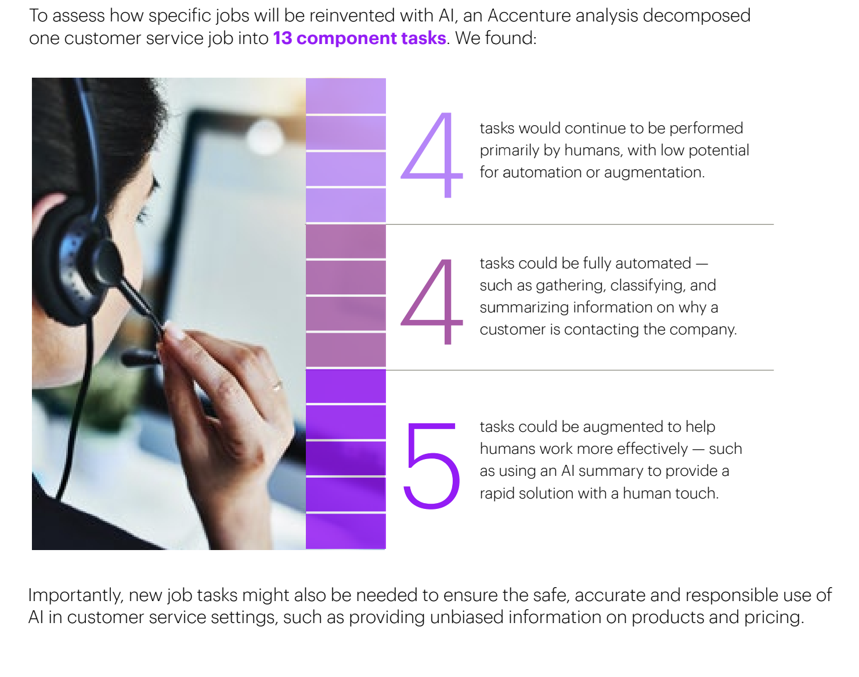
Reinventing Existing Roles
Accenture, a consulting firm, highlights a process of translating existing jobs into underlying bundles of tasks.
Then, they assess the extent to which generative AI might affect each task — automated, augmented, or unaffected.
Finally, they add new tasks related to human oversight of machines.
Notes:
Source: https://www.accenture.com/content/dam/accenture/final/accenture-com/document/Accenture-A-New-Era-of-Generative-AI-for-Everyone.pdf
Accenture

Slide 10
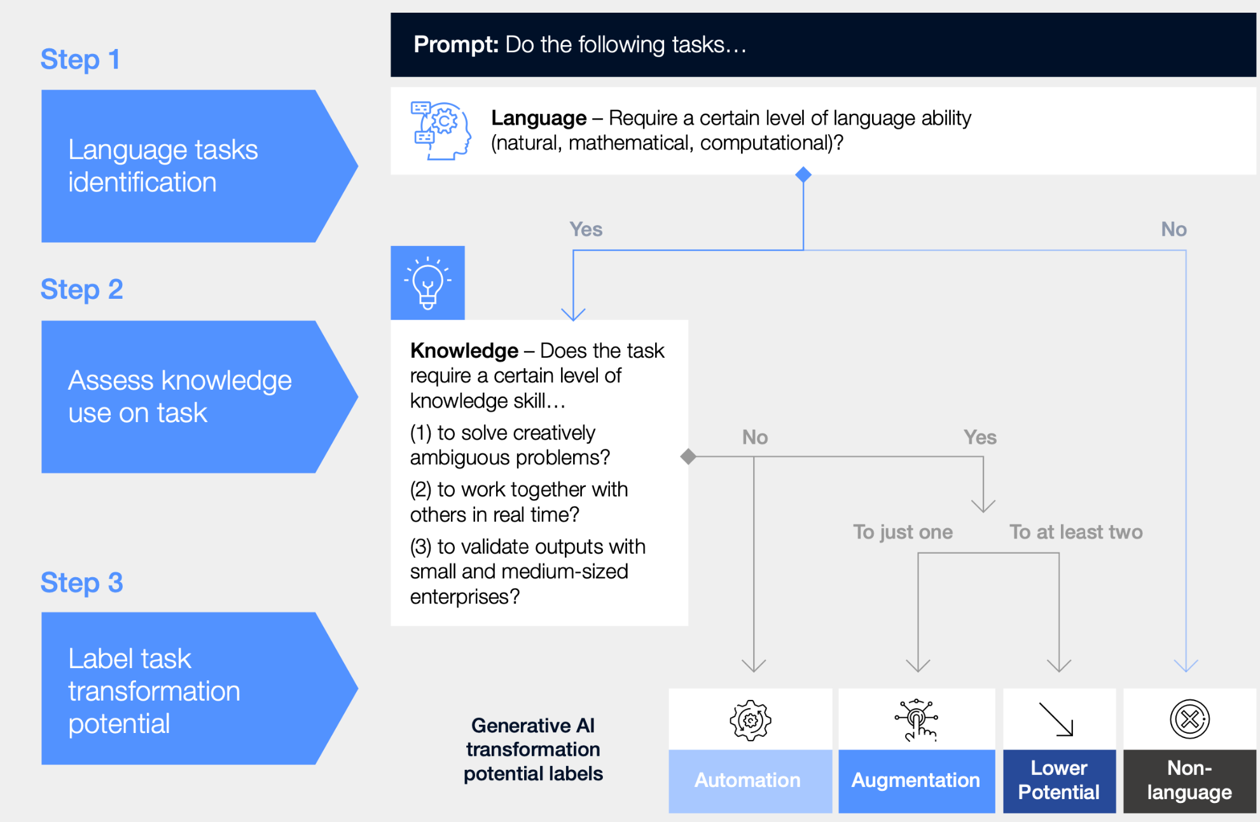
Steps to Identify Automation/Augmentation Potential
Knowledge - Does the task require a certain level of knowledge or skill...
(1) to solve creatively
ambiguous problems?
(2) to work together with
others in real time?
(3) to meet a commitment or compliance, e.g. legal, financial, health?
Source: Jobs of Tomorrow: Large Language Models and Jobs
Notes:
Source: https://www3.weforum.org/docs/WEF_Jobs_of_Tomorrow_Generative_AI_2023.pdf
This is how Accenture and the WEF triaged tasks.
Later we’re going to get ChatGPT to help us witht this task, but first we need to conver the steps into text format.

Slide 11
Knowledge Check:
Identifying exposure potential of tasks and jobs
Tariq is a therapist who is evaluating his client’s mental health conditions and considering various treatment options. What category does this task belong to?
A) Higher potential for automation
B) Higher potential for augmentation
C) Lower potential for exposure (automation or augmentation)
D) Non-language tasks

Slide 12
Knowledge Check:
Identifying exposure potential of tasks and jobs
Tariq is a therapist who is evaluating his client’s mental health conditions against guidance criteria and considering treatment options. What category does this task belong to?
A) Higher potential for automation
B) Higher potential for augmentation
C) Lower potential for exposure (automation or augmentation)
D) Non-language tasks
Does the task require a certain level of knowledge or skill...
❌to solve creatively ambiguous problems?
❌to work together with others in real time?
✅to meet a commitment or compliance, e.g. legal, financial, health?
Rationale: Evaluating patient or client conditions and treatment options is a task with a higher potential for augmentation. LLMs can assist in making a diagnosis and help reduce bias when it comes to treatment options.

Slide 13
Knowledge Check:
Identifying exposure potential of tasks and jobs
Priya is a database administrator who is responsible for designing databases. What category does her task primarily belong to?
A) Higher potential for automation
B) Higher potential for augmentation
C) Lower potential for exposure (automation or augmentation)
D) Non-language tasks

Slide 14
Knowledge Check:
Identifying exposure potential of tasks and jobs
Priya is a database administrator who is responsible for designing databases. What category does her task primarily belong to?
A) Higher potential for automation
B) Higher potential for augmentation
C) Lower potential for exposure (automation or augmentation)
D) Non-language tasks
Does the task require a certain level of knowledge or skill...
❌ to solve creatively ambiguous problems?
❌to work together with others in real time?
❌to meet a commitment or compliance, e.g. legal, financial, health?
Rationale: Designing databases falls under tasks with a higher potential for automation. LLMs can automatically generate database schemas based on inputs, though human oversight is still valuable for complex systems.

Slide 15
Knowledge Check:
Identifying exposure potential of tasks and jobs
Sarah, a supply chain manager, is responsible for negotiating contracts with international suppliers. Which category does her task belong to?
A) Higher potential for automation
B) Higher potential for augmentation
C) Lower potential for exposure (automation or augmentation)
D) Non-language tasks

Slide 16
Knowledge Check:
Identifying exposure potential of tasks and jobs
Sarah, a supply chain manager, is responsible for negotiating contracts with international suppliers. Which level does her task belong to?
A) Higher potential for automation
B) Higher potential for augmentation
C) Lower potential for exposure (automation or augmentation)
D) Non-language tasks
Does the task require a certain level of knowledge or skill...
✅to solve creatively ambiguous problems?
✅to work together with others in real time?
✅to meet a commitment or compliance, e.g. legal, financial, health?
Rationale: Sarah’s task of negotiating contracts falls under tasks with lower potential for exposure to automation or augmentation, owing to needing all three knowledge skills. But she could still consider using an LLM coach.

Slide 17
Group Discussion:
Triage the Tasks in Your Role

Slide 18
Group Discussion: Triaging Tasks
10 Minutes
Instead of working solo, let’s make this a collaborative exploration. Discuss and list your main responsibilities, then decide as a group what can be automated or augmented. Here’s how to proceed:
1
Take a few minutes to reflect on your current role or a past role. Write down all the main tasks you are responsible for.
2
Take turns sharing your lists with the group.
3
For each task, discuss whether it can be automated (technology does it for you) or augmented (technology helps you do it better).
4
As a group, select one task that is most suitable for automation and one for augmentation.
Notes:
GROUP ACTIVITY
Go through the instructions - provide a quick demo if students are confused.
Students complete activity. Monitor their progress and answer questions throughout.
Debrief after the activity:
How did the process of discussing task automation and augmentation with the group change your perspective on your own role's responsibilities?
Which task did your group decide was most suitable for automation, and what were the key factors that led to that decision?

Slide 19
Automation & Augmentation

Slide 20
Reflection: Automation & Augmentation Plans
1
Which tasks are you most keen to Automate or Augment?
2
How will you use the task triage to decide which tasks to work on first?
3
Did you “borrow” some tasks from another occupation?
4
How much is compliance a factor in your role? Real-time collaboration? Creative ambiguity?
Notes:
- Ask participants to reflect on their own, either in their own heads or by jotting down notes
- If they would like to share their reflections, let them know they can do so in the Zoom chat

